Slide 1

RATINGS PROJECT

Slide 2
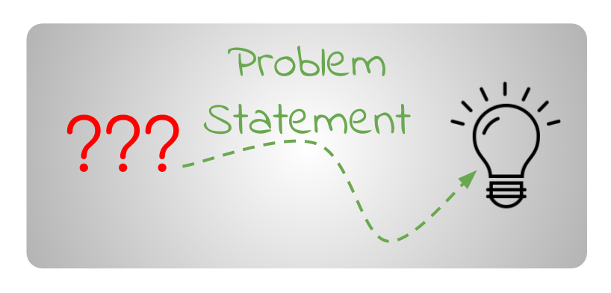
Problem Statement

Slide 3
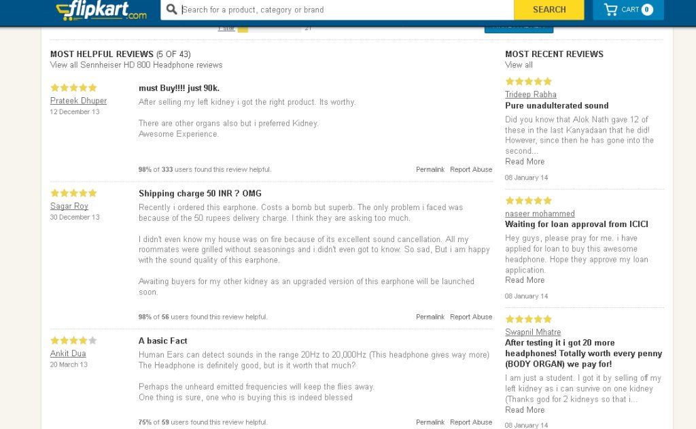
Client has a website where people write different reviews for technical products. Now they are adding a new feature to their website i.e. The reviewer will have to add stars(rating) as well with the review.

Slide 4
The rating is out 5 stars and it only has 5 options available 1 star, 2 stars, 3 stars, 4 stars, 5 stars
Now they want to predict ratings for the reviews which were written in the past and they don’t have a rating. So, we have to build an application which can predict the rating by seeing the review

Slide 5
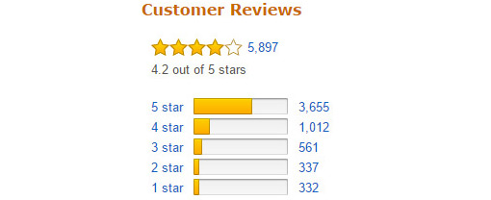
Problem in hand
The model should be able to accept any review of the customer and predict the rating that could be given for the review between 1 to 5.

Slide 6
Technology Used for the Project
Hardware technology being used.
RAM : 8 GB
CPU :Intel® Core™ i7-10510U CPU @ 1.80GHz
GPU: NVIDA-Cuda , performed in tf2.4 enviroment
Software technology being used.
Programming language : Python
Distribution : Anaconda Navigator
Browser based language shell : Jupyter Notebook
Libraries/Packages specifically being used.
Pandas , NumPy, matplotlib, seaborn, scikit-learn, pandas-profiling, missingno

Slide 7
Data Mining
Data Mined from Reviews of laptops, Phones, Headphones, smart watches, Professional Cameras, Printers, Monitors, Home theater, Router from Flipkart.come

Slide 8
Data Preprocessing Done
removing unwanted column-unnamed
Removing Punctuations and other special characters
Removing Stop Words
adding POS tags with lemmatization

Slide 9
converting text to numerical through n-gram tfidf vectorizer
vectorizing into charachter level
clubbing the word and the charachter vector
handling imbalanced data through smote technique

Slide 10
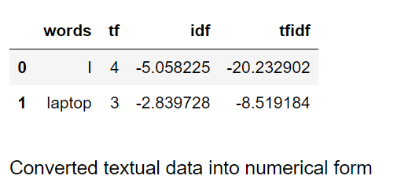
Feature extraction

Slide 11
Exploratory Data Analysis
Word count-splitting the words as per spaces and plotting its histogram
Charachter count
Average word length
Frequency distribution of top 30words
Frequency distribution top 30 rarest words

Slide 12

Data visualization and analysis

Slide 13
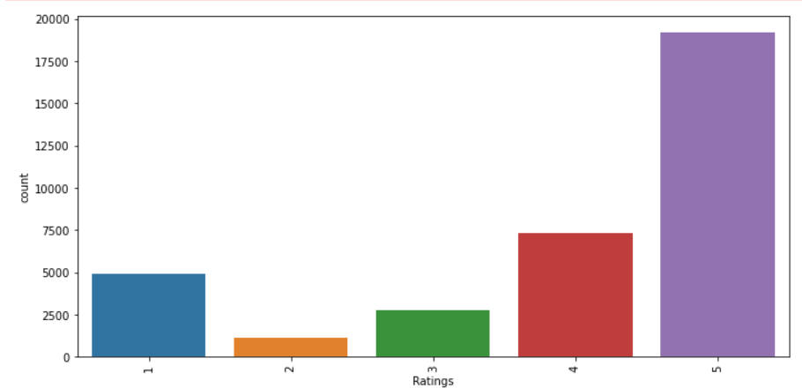
Ratings
The data is unbalanced with 5 rating data to be highest and 2 rating data to be the lowest

Slide 14
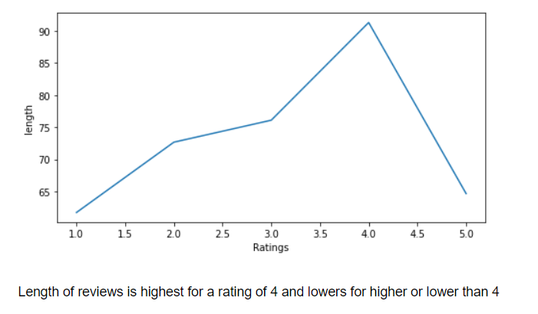
Length of Ratings

Slide 15
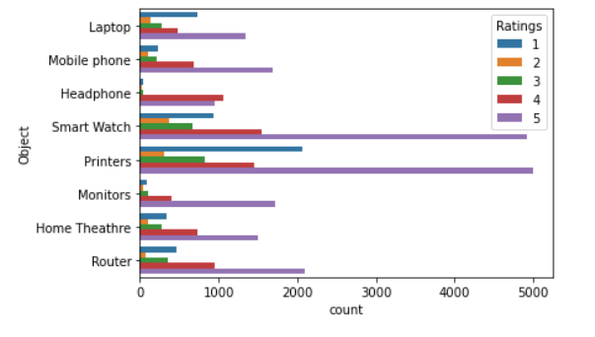
Ratings of the Objects whose reviews are taken

Slide 16
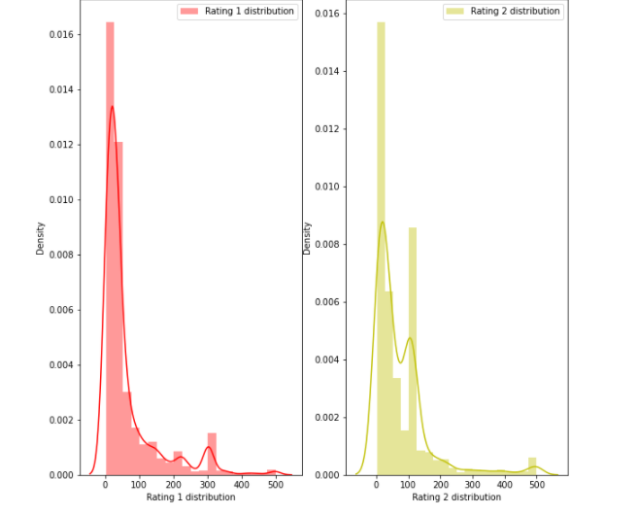
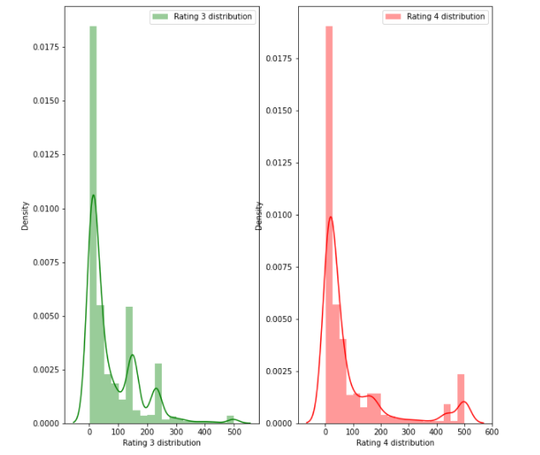
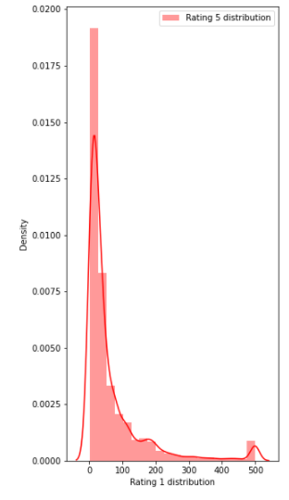
Ratings distribution
Rating 1
Rating 2
Rating 3
Rating 4
Rating 5

Slide 17
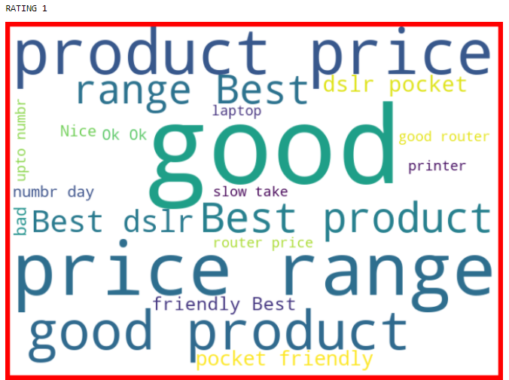
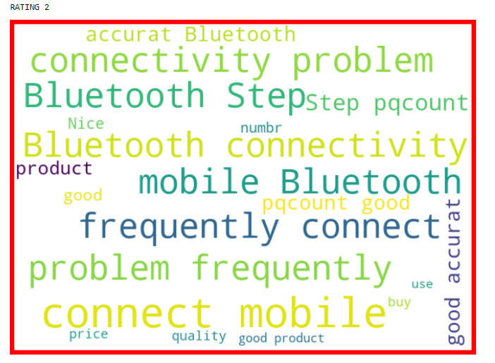
WORD CLOUD OF EACH RATINGS
Largest number of word is good
Largest number of word is connect mobile

Slide 18
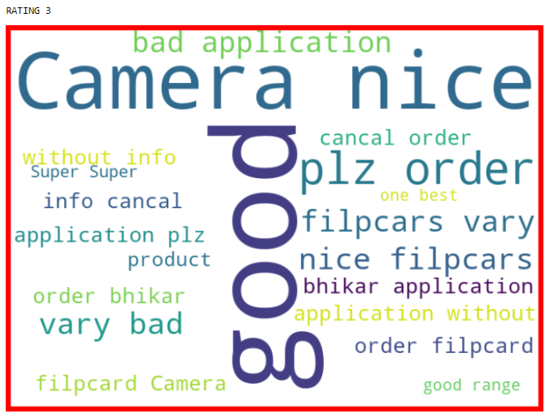
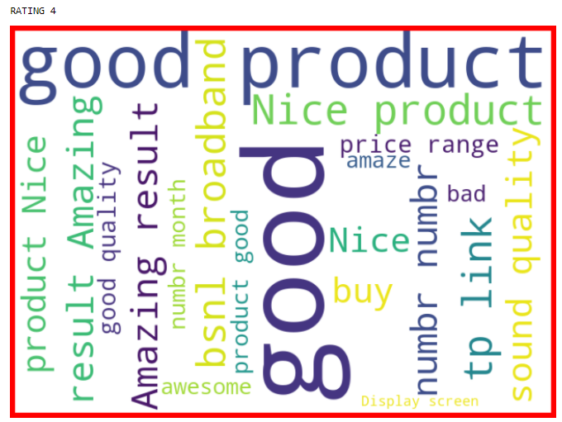
Largest number of word is good
Largest number of word is good

Slide 19
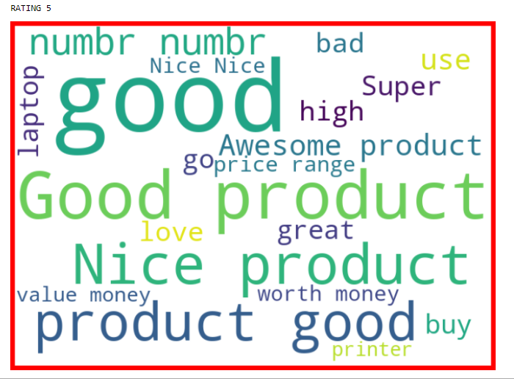
Largest number of word is good

Slide 20
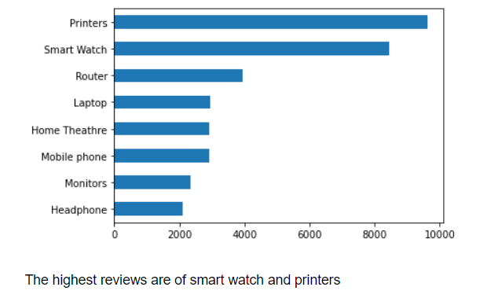
Objects whose reviews are taken

Slide 21
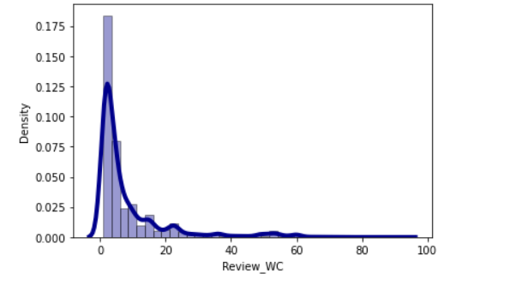
Word Count
Words are highest in sentences upto 3 words

Slide 22
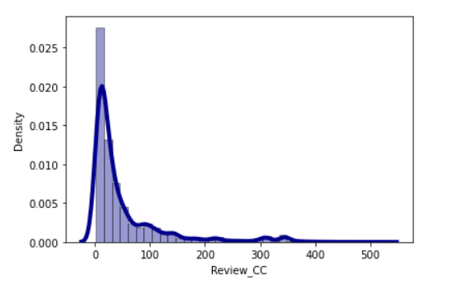
Character count
Highest Characters seen in sentences are 14 Characters

Slide 23
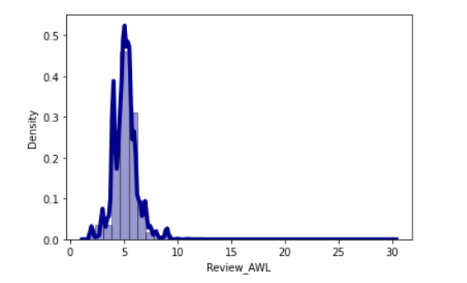
Average word length

Slide 24
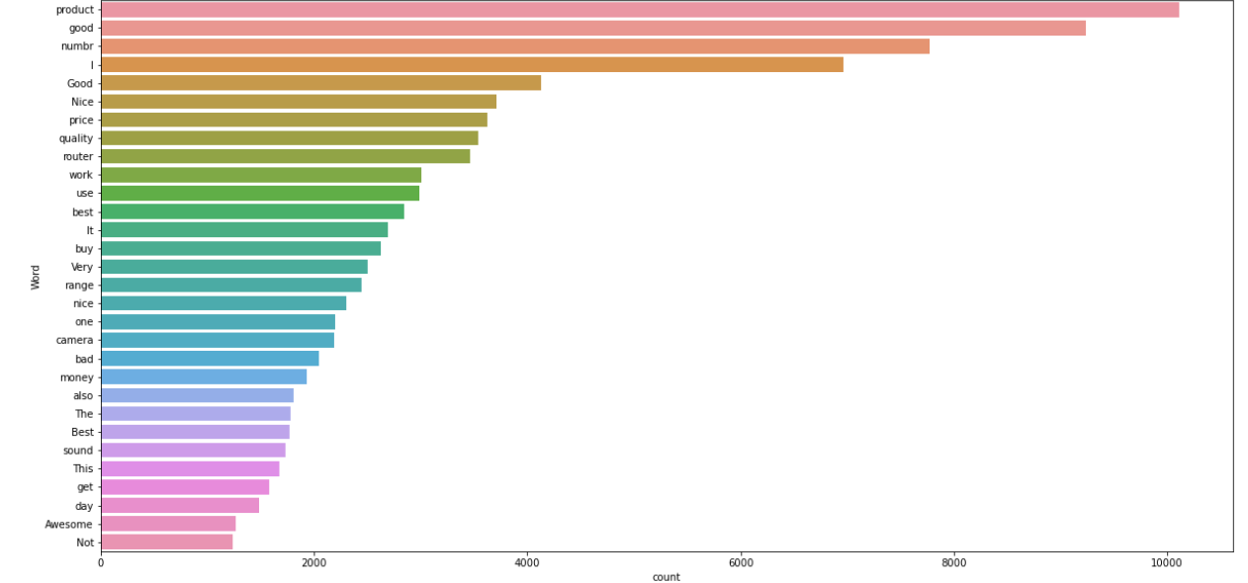
Frequency distribution of top 30 words
Product word is maximum seen in the sentences

Slide 25
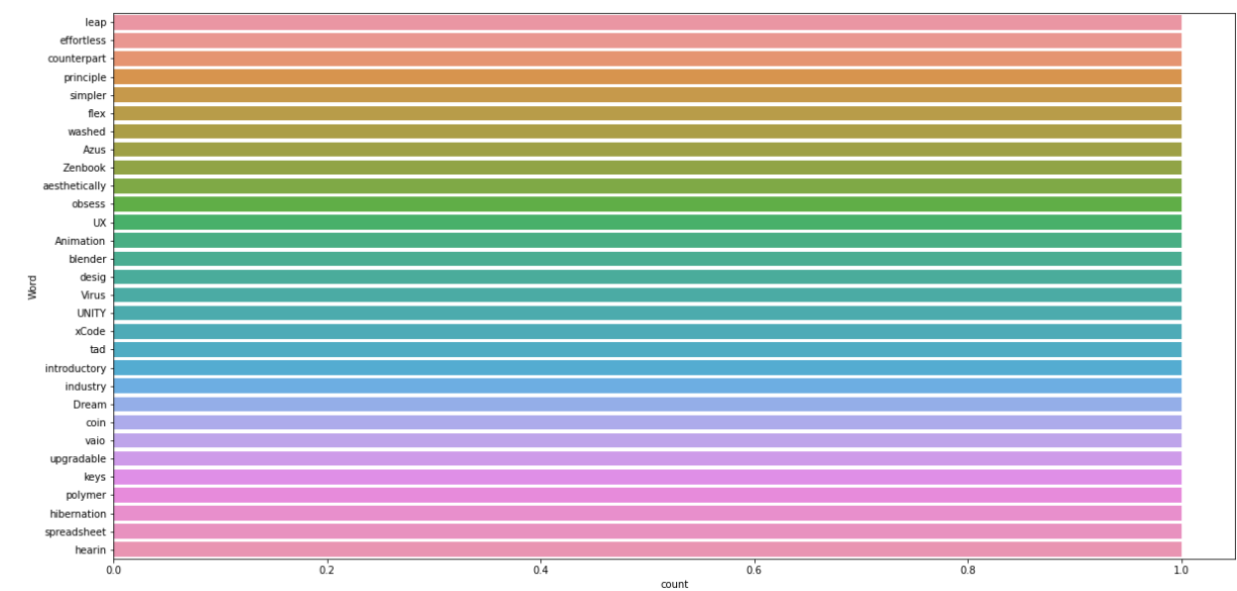
Frequency distribution of rarest 30words

Slide 26
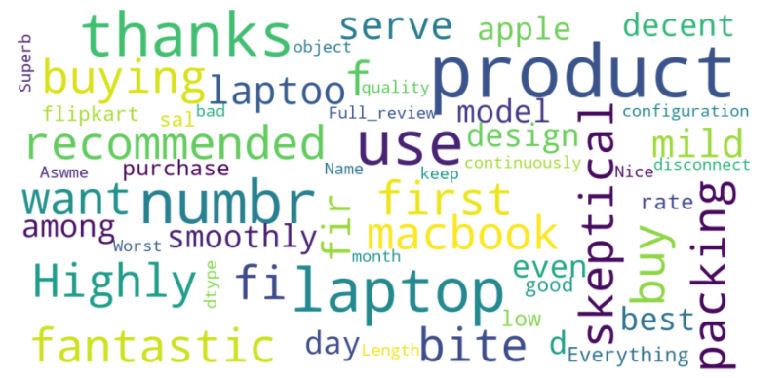
Word Cloud for the Reviews taken
The highest word occurence is of product

Slide 27
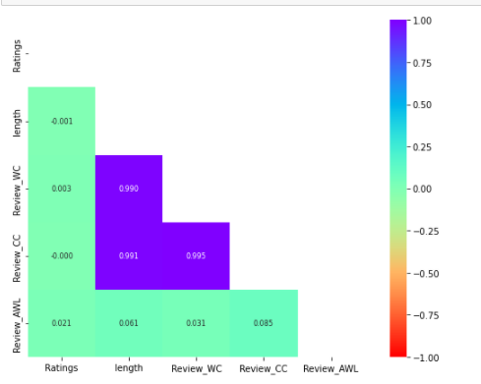
HEAT MAP

Slide 28
Model/s Development and Evaluation

Slide 29
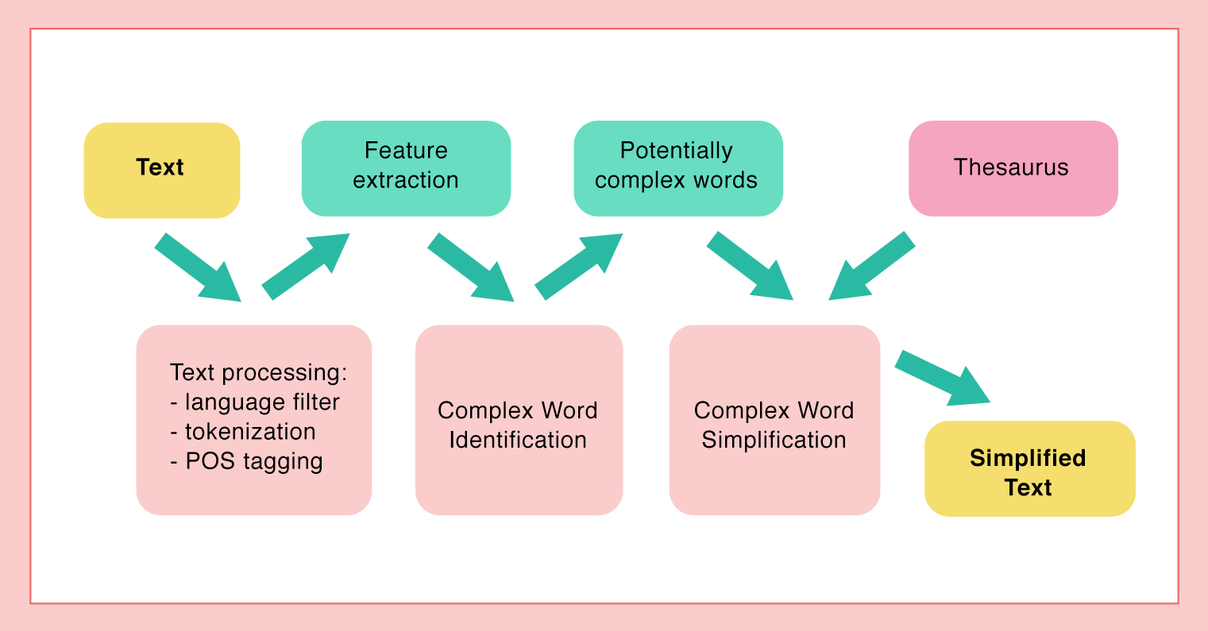
MODEL DEVELOPMENT PIPELINE

Slide 30
Identified Approaches (Algorithms) for classification
KNeighborsClassifier
RandomForestClassifier
GradientBoostingClassifier
DecisionTreeClassifier
AdaBoostClassifier
BaggingClassifier
XGBClassifier
MultinomialNB
ExtraTreesClassifier

Slide 31
Choosing Best Model
The model chosen is of Gradient Boosting Classifier. It has the good accuracy score and least difference with the cross val score which shows it has less over fitting

Slide 32
Accuracy score of the chosen model

Slide 33
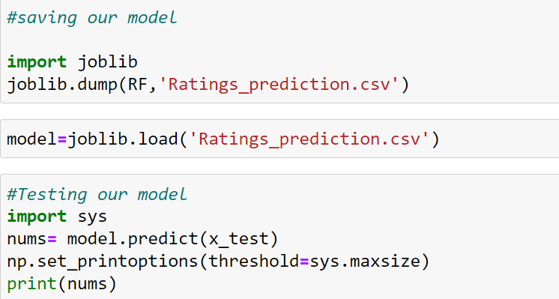
Saving the model

Slide 34
THANK YOU Have a nice day

